Slide 1


Team 60: RADIAN
Bi-Weekly Update 2 Matthew Blackwell, Mitchell Hoffman, Wyatt Johnson Sponsor: Dr. Arya Menon TA: Manoj Kumar Balamurugan
Notes:
Michelle

Slide 2

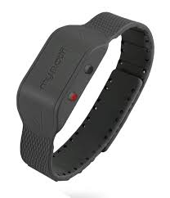
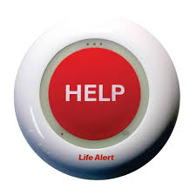
Problem Statement
Falls are the leading cause of injury in elderly
Fast detection saves lives through quick response
Current Solutions - Limitations:
Wearables → must be worn and charged
Push-buttons → user must be conscious/able to press
Camera → effective but invade privacy

Slide 3
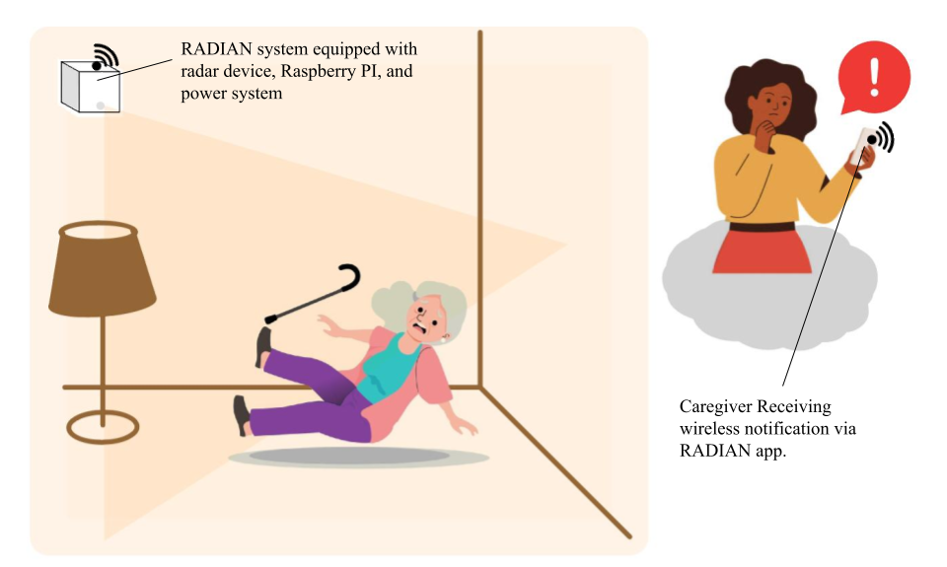
RADIAN System Summary
Proposed Solution:
Automatic Fall Detection
Works in real time
No user action needed
Privacy-Preserving
No camera
Protects independence
Reliable Response
Immediate accurate alerts to caregivers

Slide 4
System Overview
External Casing and Radome
Matthew Blackwell
Wyatt Johnson
PCB
Mitchell Hoffman
TI AWR6843
Phone App
Battery
External Alarm
Watchdog Timer
Serial (UART or USB)
Raspberry Pi 3
AI Algorithm / Signal Processing

Slide 5
RADIAN Project Timeline
Subsystem Review (completed 1/26) | Updating and testing subsystems (Wireless and Physical) (completed 2/2) | Updating subsystem (Data) (To be complete by 2/16) | Collect radar testing data and trials (Ongoing until 3/9) | Basic integration between subsystems (To complete by 2/19 (Blitz)) | Full RADIAN System Test (To complete by 3/16) | Validation Testing (To be complete by 4/6) | Final Demo and Report (To be complete by 4/20)
Notes:
Eric

Slide 6
Data Subsystem
Matthew Blackwell
Accomplishments since last update ~30 hrs of effort | Ongoing progress/problems and plans until the next presentation
Completed base AI model in preparation for gathering training data with Wireless Tested integrated Gotify server from Raspberry Pi to RADIAN android app Ongoing integration by gathering radar testing data with Wireless Documenting testing procedure to ensure reliability and repeatability when gathering data | Start gathering data using Wireless’s radar board and preparing data for training Training base ML model and refining the model as results are reported Integrate with Physical by running Raspberry Pi 3 purely off of battery for a specified amount of time

Slide 7
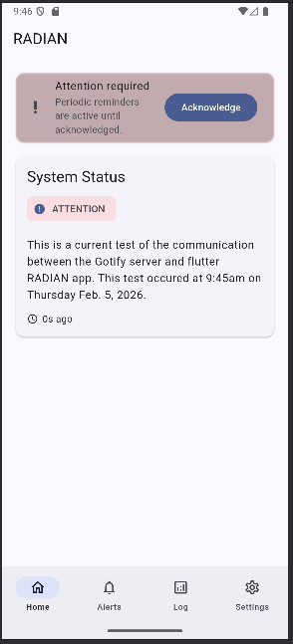
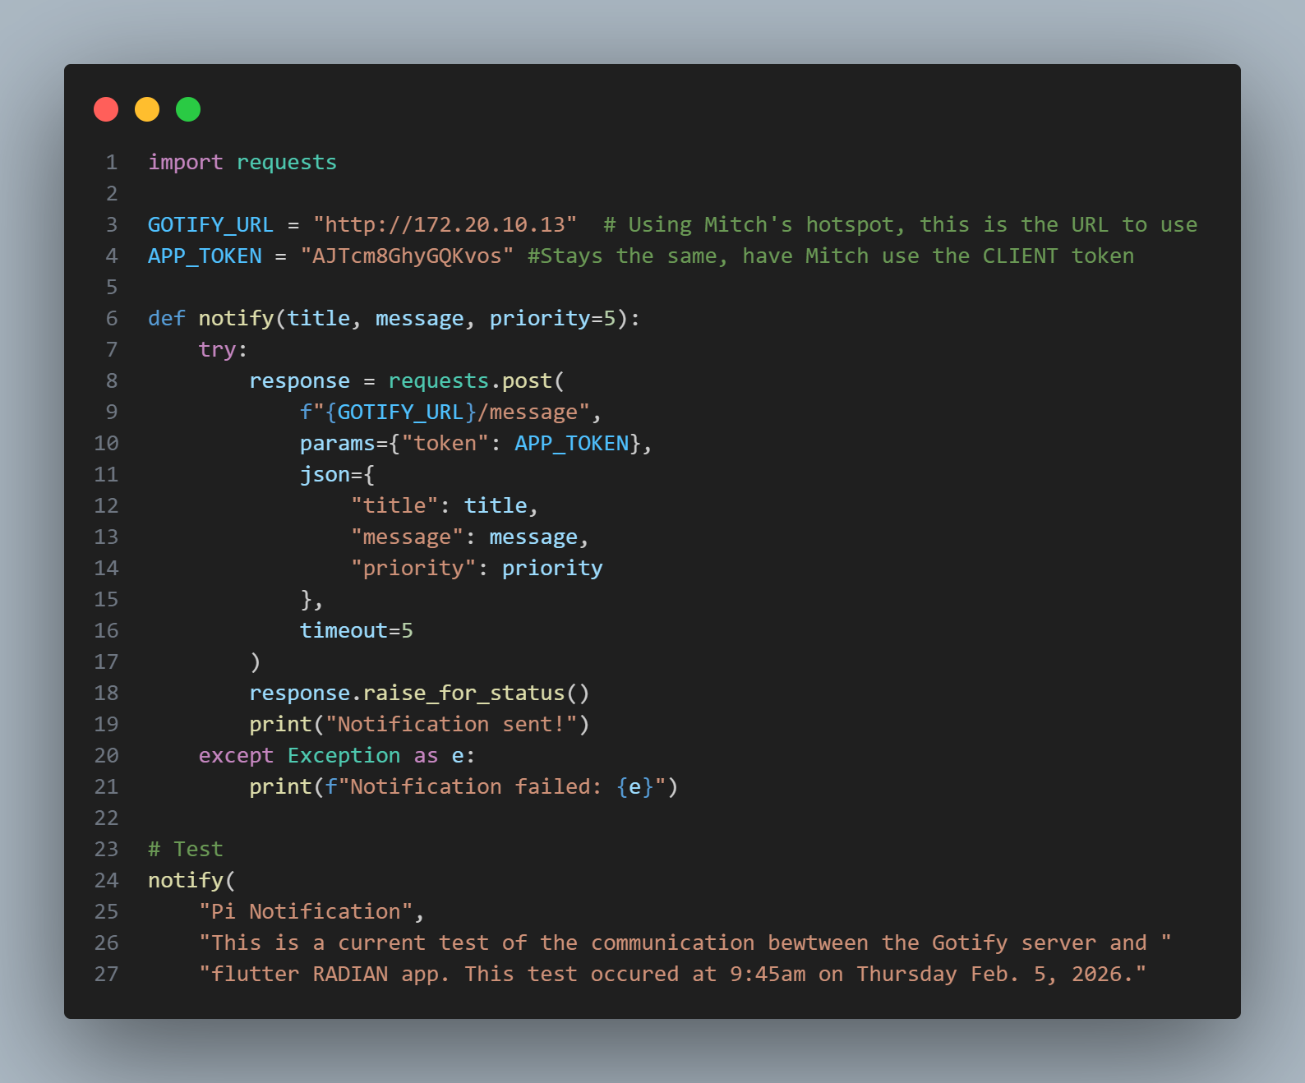
Data Subsystem
Matthew Blackwell

Slide 8
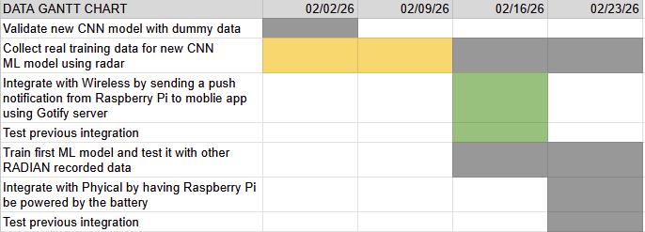
Data Gantt Chart
Data’s Two Week Plan

Slide 9
Wireless Subsystem
Mitch Hoffman
Accomplishments since last update ~30 hrs of effort | Ongoing progress/problems and plans until the next presentation
debugged the radar data processing code for integration with pi switched from tracking object to solely detection to better utilize the ML model debugged the mobile app code for integration with pi and gotify server completed integration between the mobile app and gotify server | collecting data from the radar to train ML model for fall detection testing consistency in alerts from gotify server

Slide 10
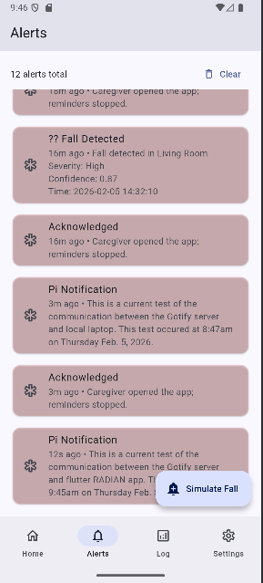
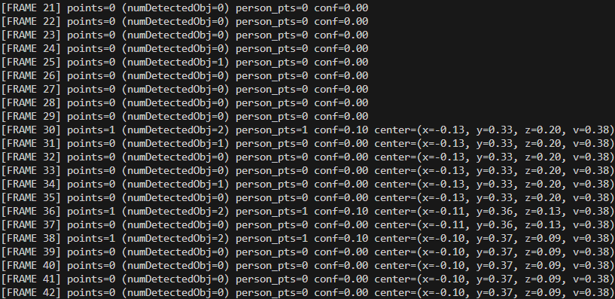
Wireless Subsystem
Mitch Hoffman

Slide 11
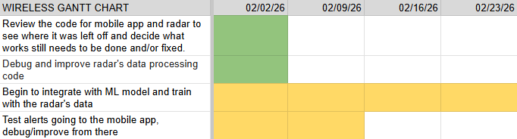
Wireless Gantt Chart
Wireless’s Two Week Plan

Slide 12
Physical Subsystem
Wyatt Johnson
Accomplishments since last update ~23 hrs of effort | Plans until the next presentation
Brought up, tested, and characterized the 2S charging circuit (MP2615) Integrated the Raspberry Pi with the power board Verified the supply can reliably power the Pi under full CPU load | Power the AWR6843 radar board from the power board/bench supply Power the radar + Raspberry Pi simultaneously Validate stable 5V at both loads and confirm UART/data communication while powered Finalize the enclosure design

Slide 13
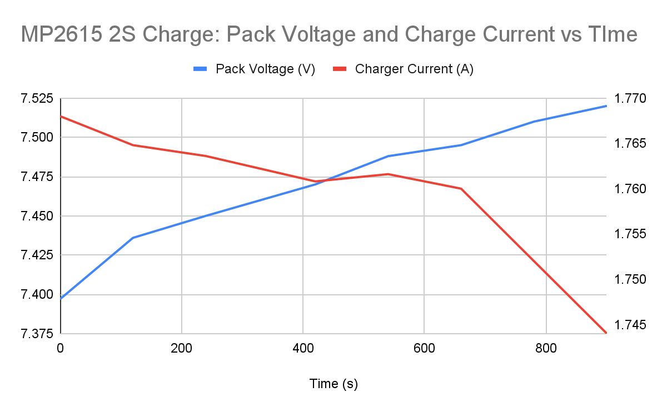
MP2615 2S Charger
Validation Snapshot
Start Voltage
7.397V
End Voltage
7.520V
Δ Voltage
+0.123V
Elapsed Time
15 min
Avg current
1.761 A

Slide 14
Power Supply Verification Test
For Raspberry Pi
Raspberry Pi Stable
Clean boot sequence
No voltage instability detected
CPU Stress Test
4 parallel CPU processes
100% utilization on all cores
60-second duration
Power Supply remind stable
Test Command Executed:
for i in 1 2 3 4; do yes > /dev/null & done; sleep 60; killall yes

Slide 15
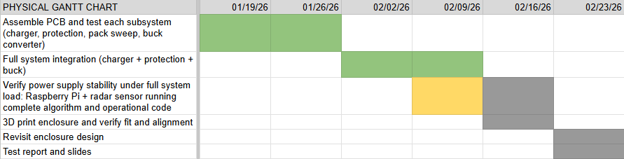
Physical Gantt Chart
Physical’s Two Week Plan

Slide 16
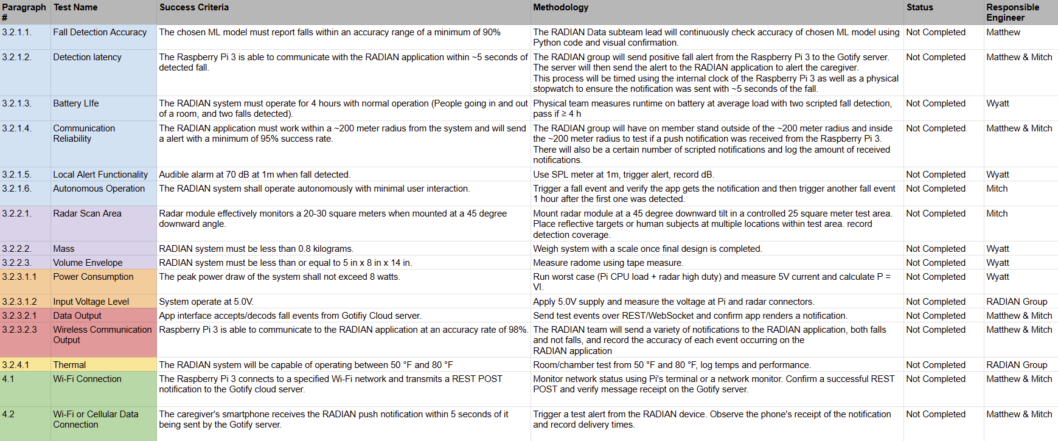
RADIAN Validation Plan
Notes:
Michelle

Slide 17
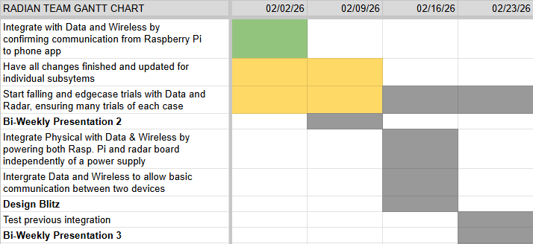
RADIAN Gantt Chart
RADIAN’s Two Week Plan
Notes:
Michelle

Slide 18
Thanks and Gig ‘Em
Any Questions?

